Slide 1
Youtube的特点和采集方案

Slide 2
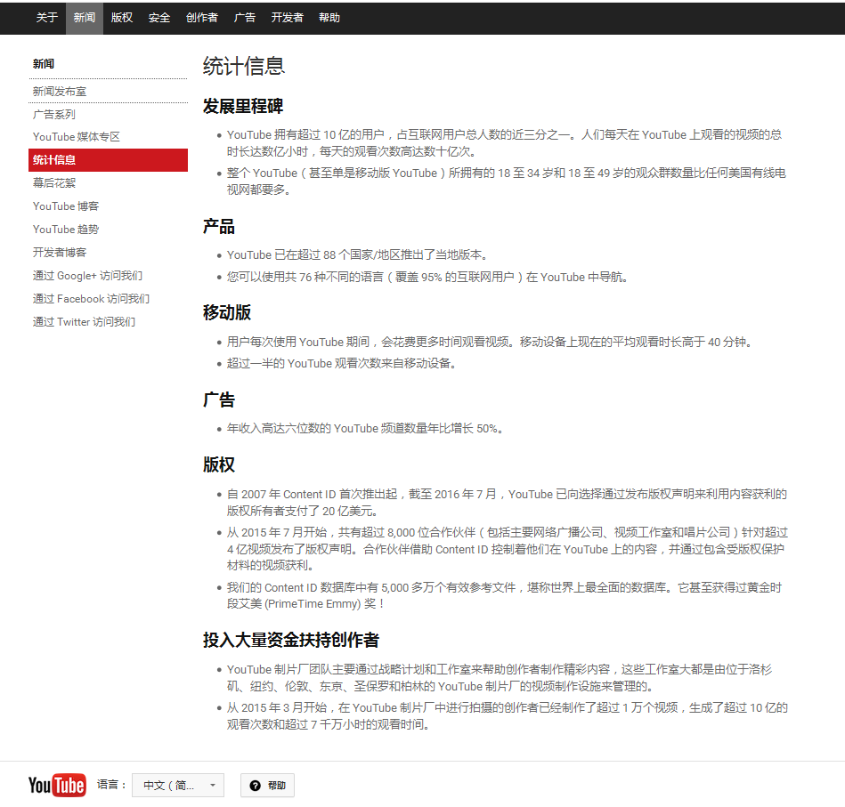
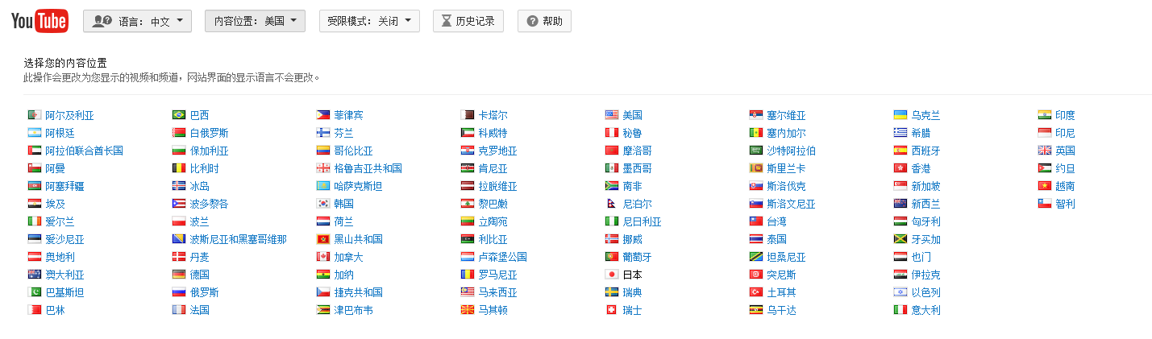
特点-1 多语言，内容发布位置（国家）多

Slide 3
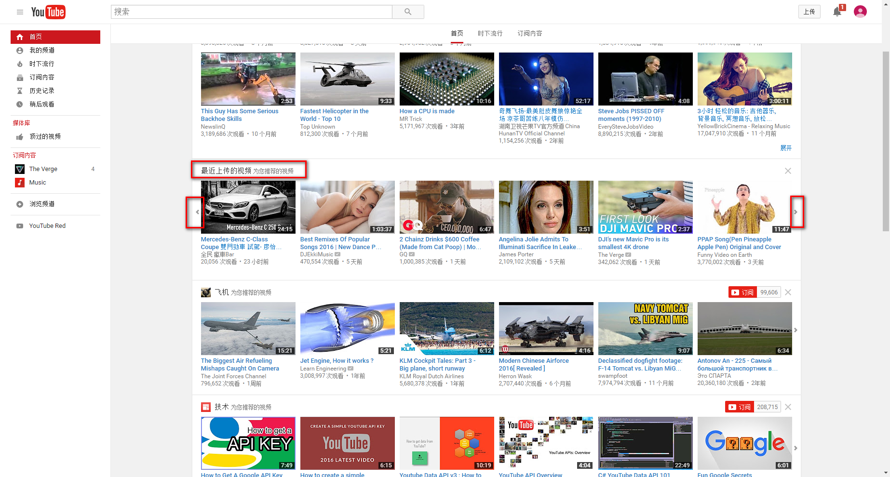
USA

Slide 4
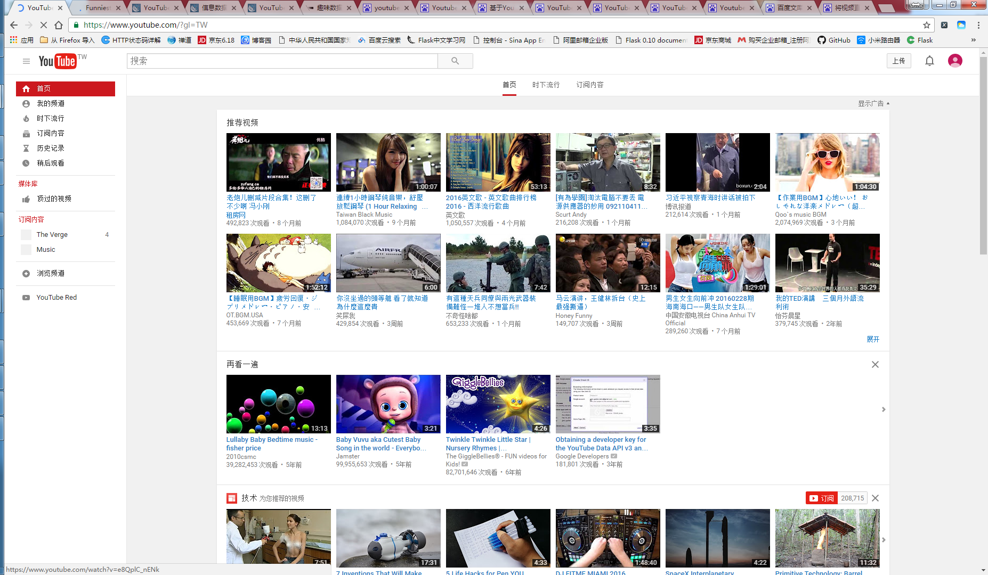
台湾

Slide 5
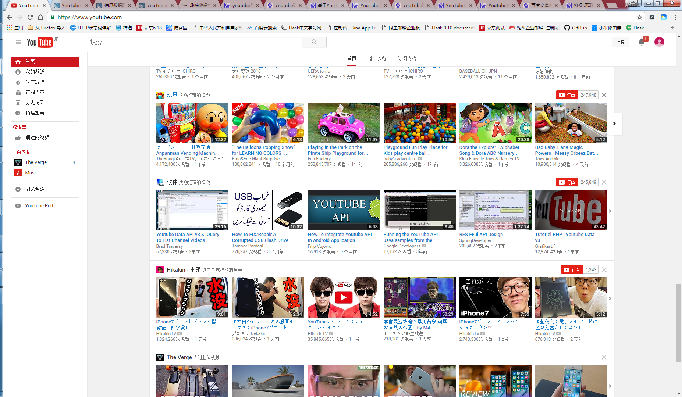
Japan

Slide 6
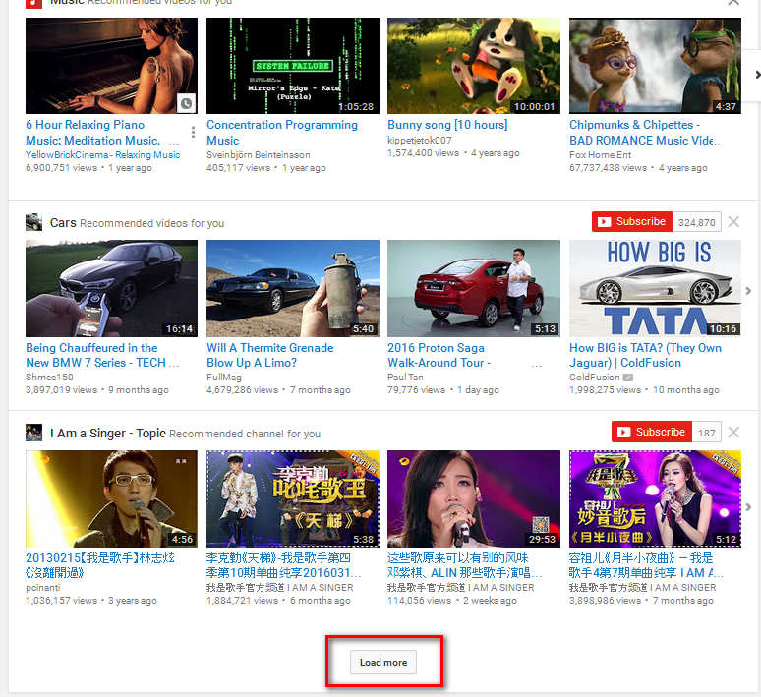
特点-2 列表页动态生成 load more之后还有动态加载的load more。。。
<button class="yt-uix-button yt-uix-button-size-default yt-uix-button-default load-more-button yt-uix-load-more browse-items-load-more-button scrolldetect" type="button" onclick=";return false;" aria-label="Load more
" data-uix-load-more-href="/browse_ajax?action_continuation=1&amp;continuation=4qmFsgJ5Eg9GRXdoYXRfdG9fd2F0Y2gaZENBaDZSME5wWjBGQlIxWjFRVUZHU1ZOM1FVSldWazFCUVZGQ1IxSllaRzlaV0ZKbVpFYzVabVF5UmpCWk1tZEJRVkZCUVVGUlJVSkJRVUZDUlVGbldYcHpVM0V4V1cweWVuZEpCAA%253D%253D&amp;direct_render=1&amp;target_id=section-list-635127" data-scrolldetect-callback="load-more-auto" data-uix-load-more-target-id="section-list-635127" data-scrolldetect-offset="600"><span class="yt-uix-button-content"> <span class="load-more-loading hid">
<span class="yt-spinner">
<span title="Loading icon" class="yt-spinner-img yt-sprite"></span>
Loading...
</span>
</span>
<span class="load-more-text">
Load more
</span>
</span></button>

Slide 7
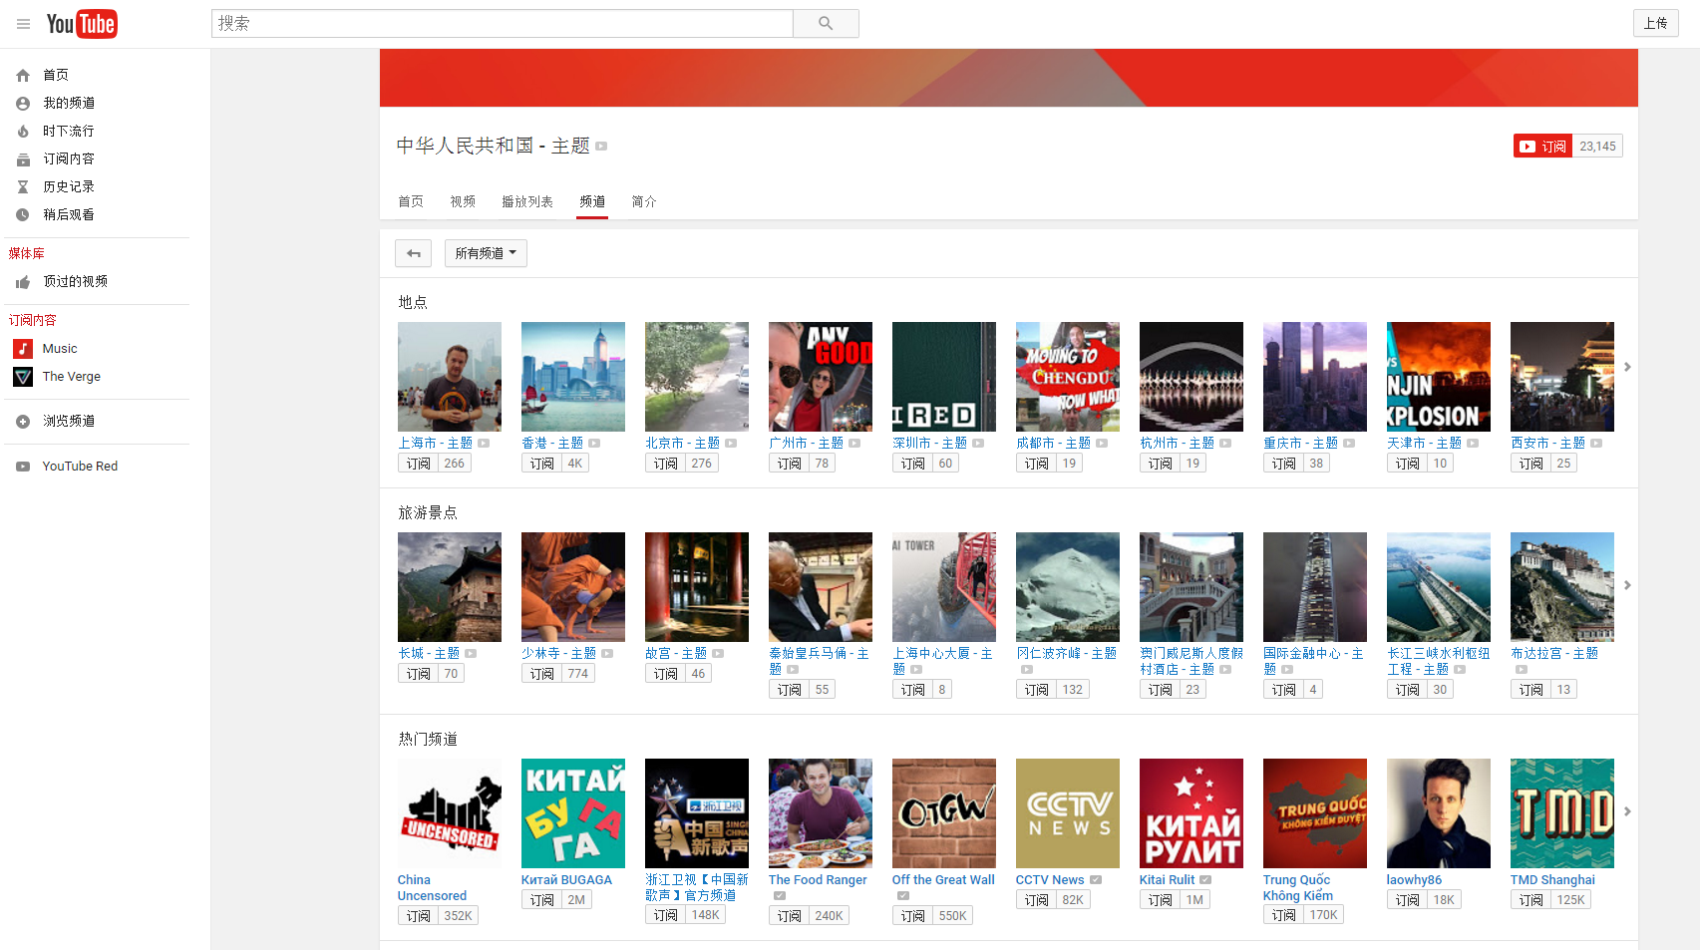
特点-3 频道多，没有特定明显的层级和规则

Slide 8
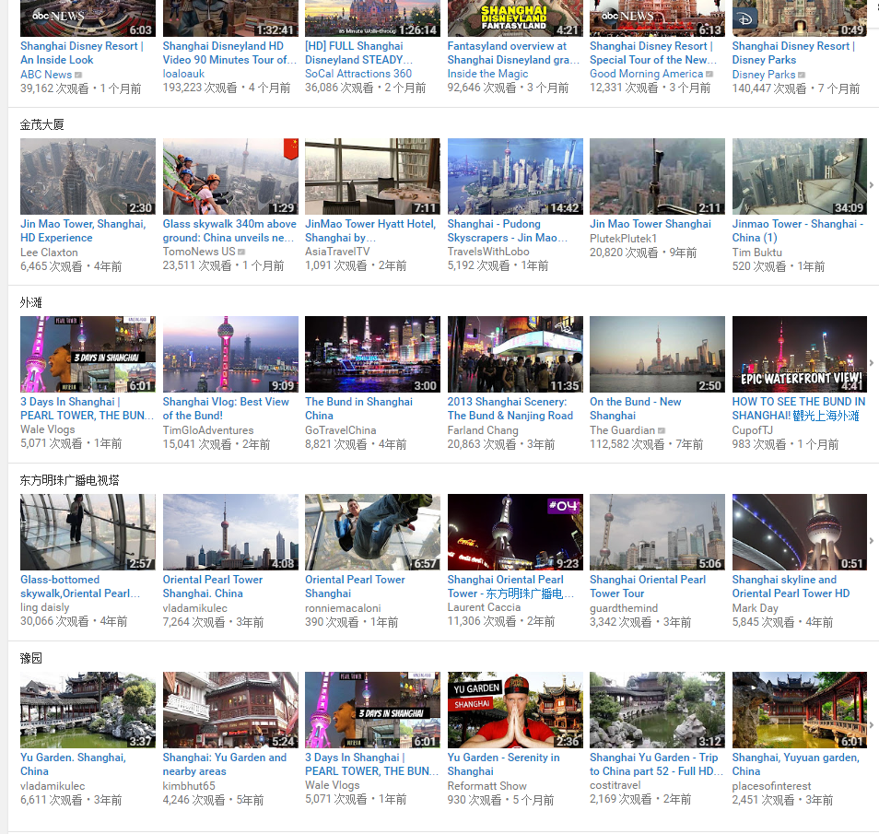
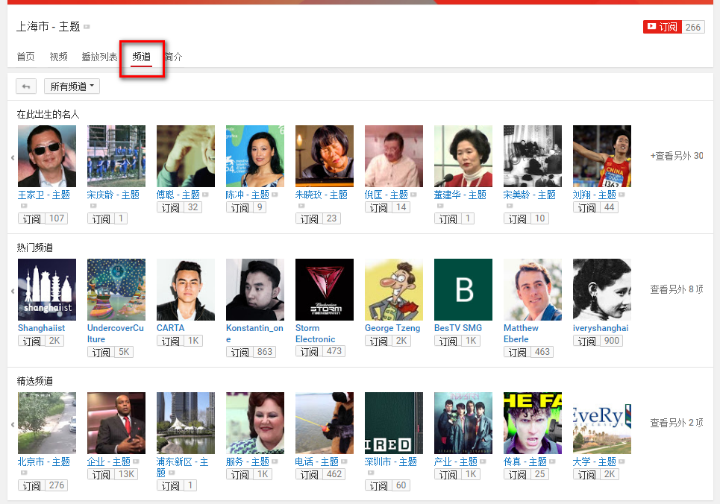
特点-3 频道多，没有特定明显的层级和规则
并不等价于左侧主题的全部频道

Slide 9
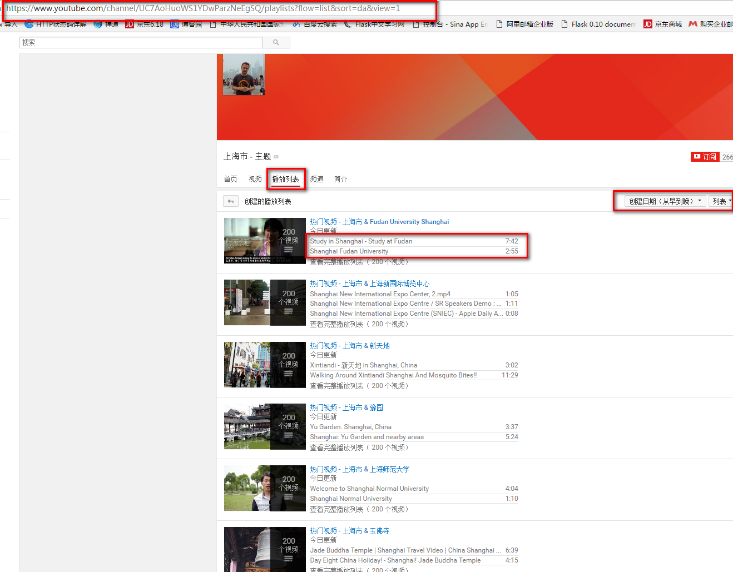
特点-3 频道多，没有特定明显的层级和规则
播放列表较为规则，但是取得全部列表，仍然是不停的动态请求。

Slide 10
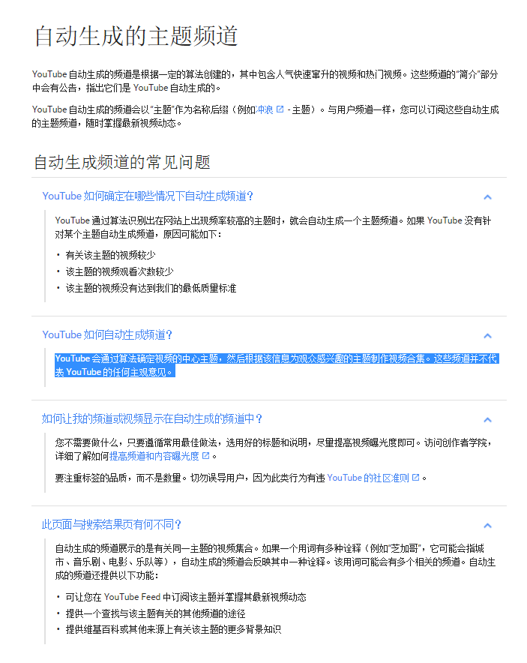
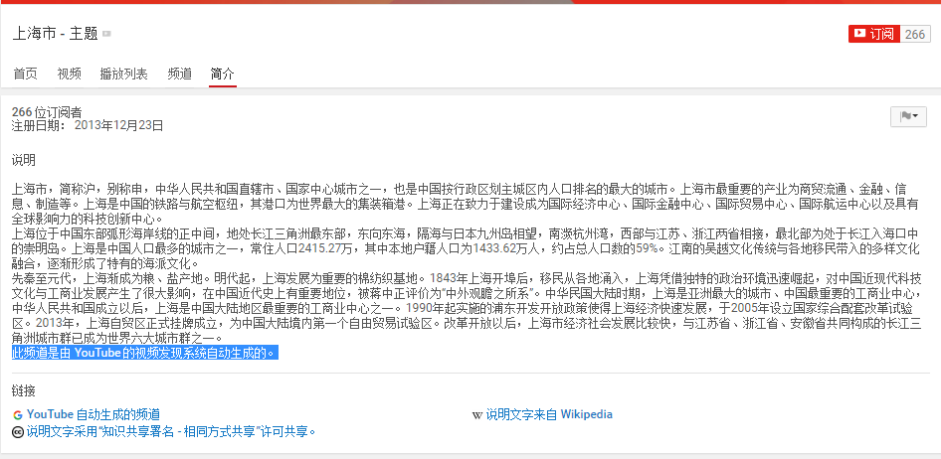
特点3 频道多，没有特定明显的层级和规则（自动生成频道）

Slide 11
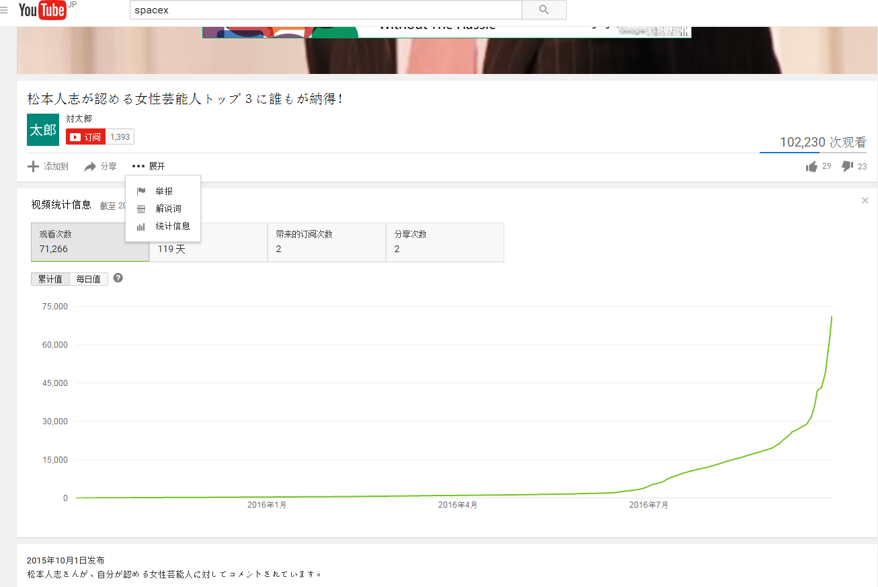
特点-4 自带视频统计信息，解说词（机器识别） （如果能够提取相当于详情页的文本内容）

Slide 12
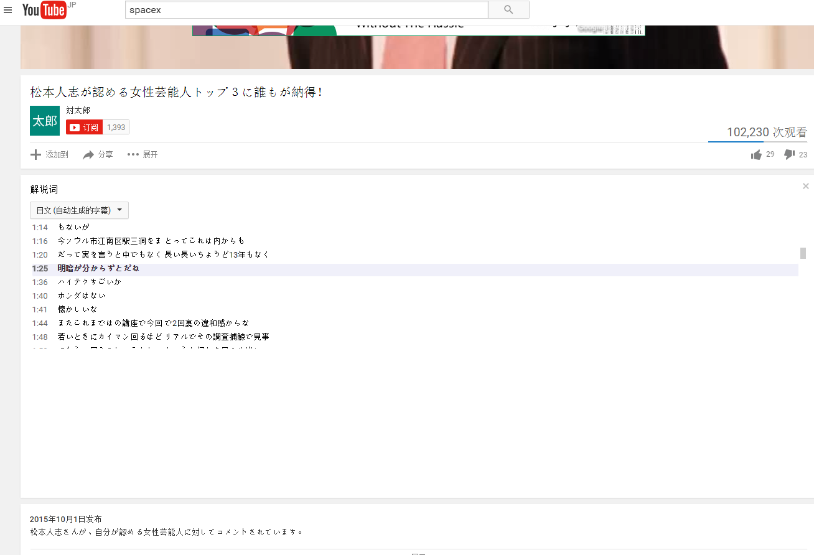
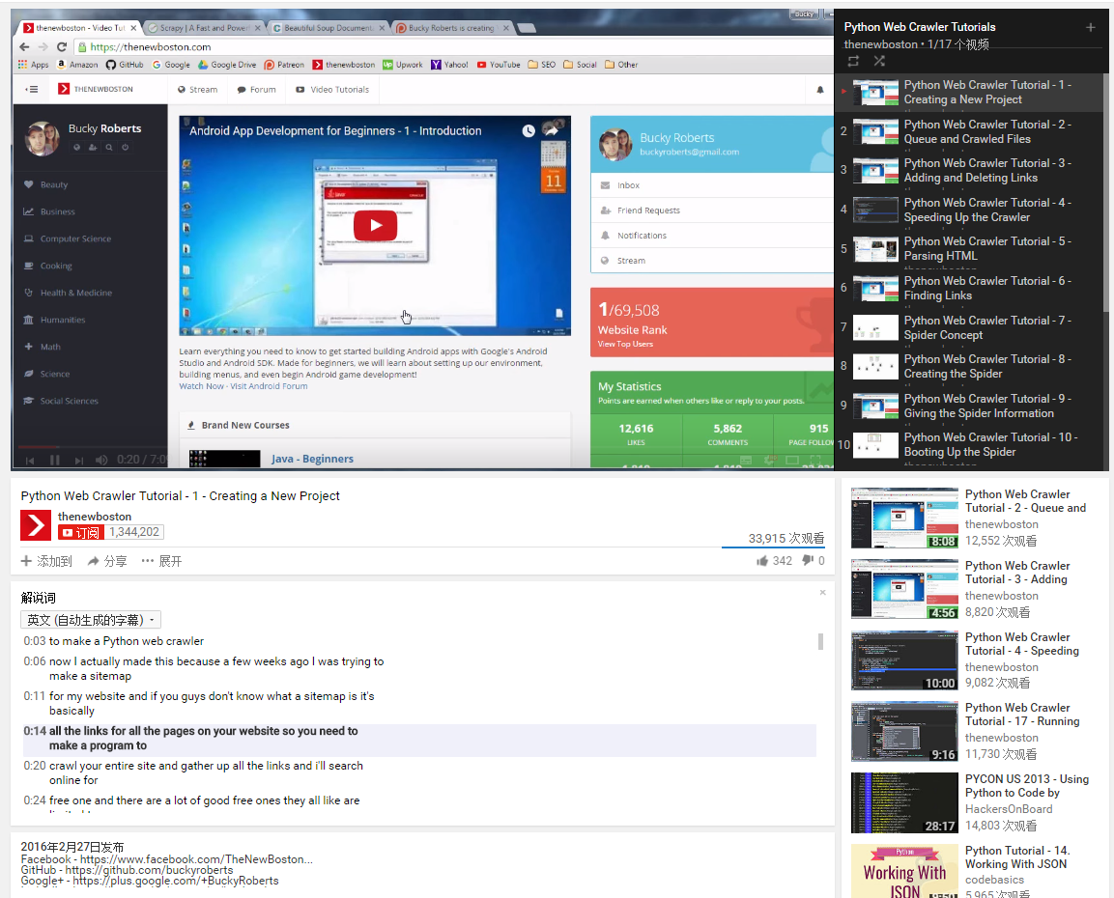
特点-4 自带视频统计信息，解说词 （如果能够提取相当于详情页的文本内容）

Slide 13
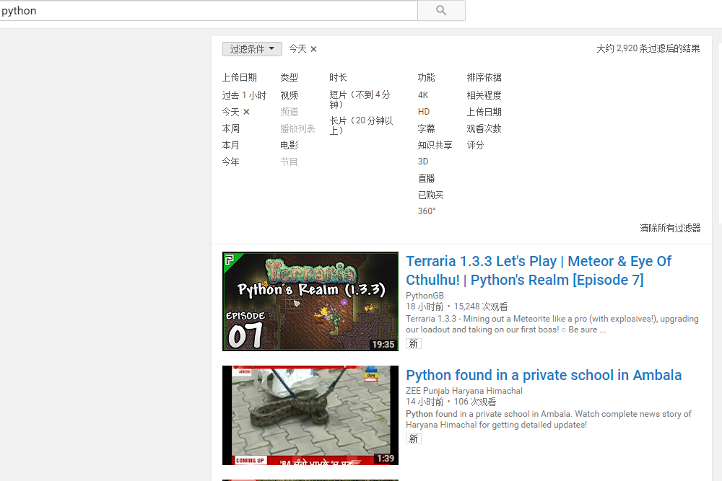
特点-5 自带过滤（时间，排序）方法，但是需要进入关键词检索。

Slide 14
方案1 通常的逐级采集 频道-> 列表->详情
内容位置（国家）-> 频道 -> 列表 -> 视频文字信息
获得列表过程中：需要破解不断地提取动态加载链接的规则

Slide 15
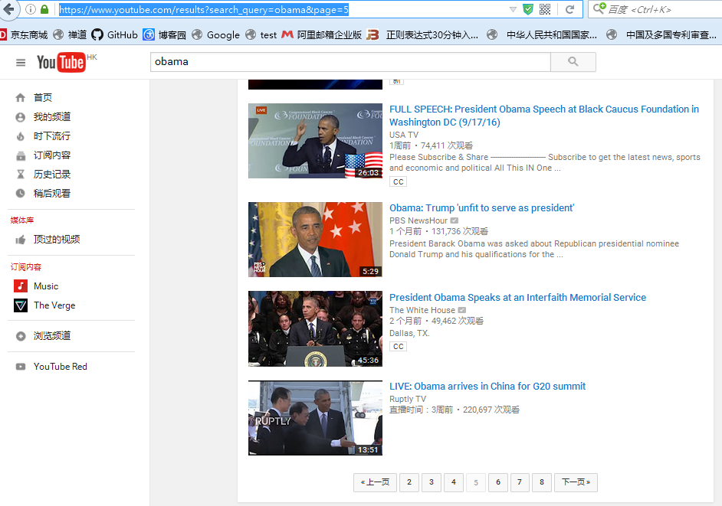
方案-2 关键词检索+全部翻页 例如： https://www.youtube.com/results?search_query=obama&page=5
问题变为如何使用关键词覆盖全站（或者热点）？

Slide 16
使用google的Data API提取comments等信息。
https://developers.google.com/youtube/v3/ 需要google开发者账号？
V2有人反映不好用了。

Slide 17

Google开发者账号

Slide 18
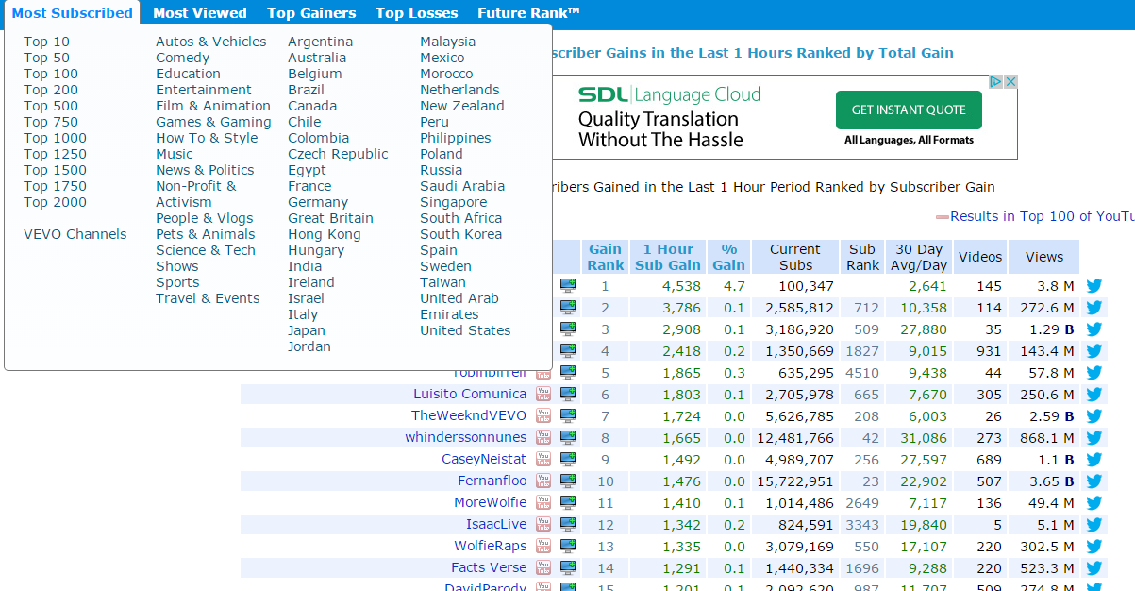
方案-3 利用现有的youtube大数据网站 – 例如：Vidstatsx 提取热点/趋势的信息
http://vidstatsx.com/collage/top-100

Slide 19
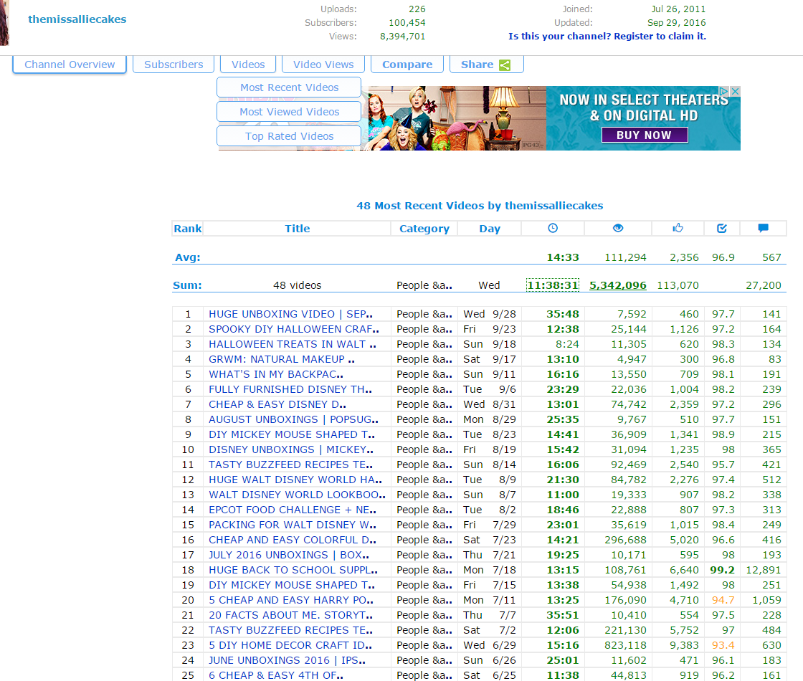
方案3）有youtube video的链接，可进一步提取内容。

Slide 20
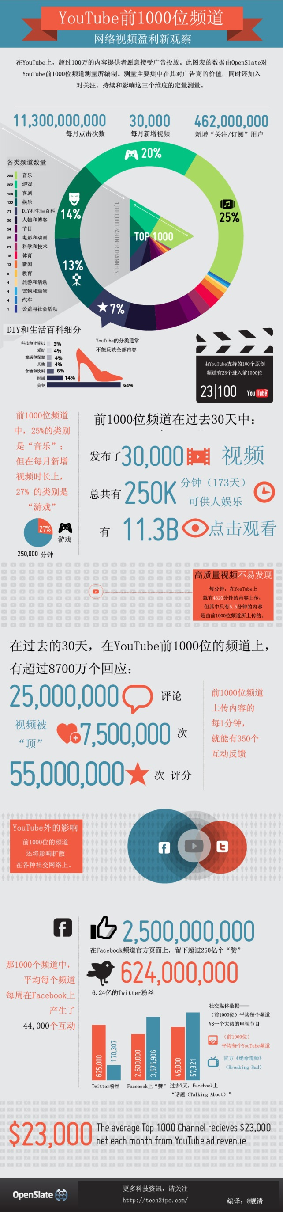
方案3） Top 1000频道 影响力
http://www.36dsj.com/archives/52053

Slide 21
channel是上传视频的集合。 playlist是你播放视频的集合。

Slide 22
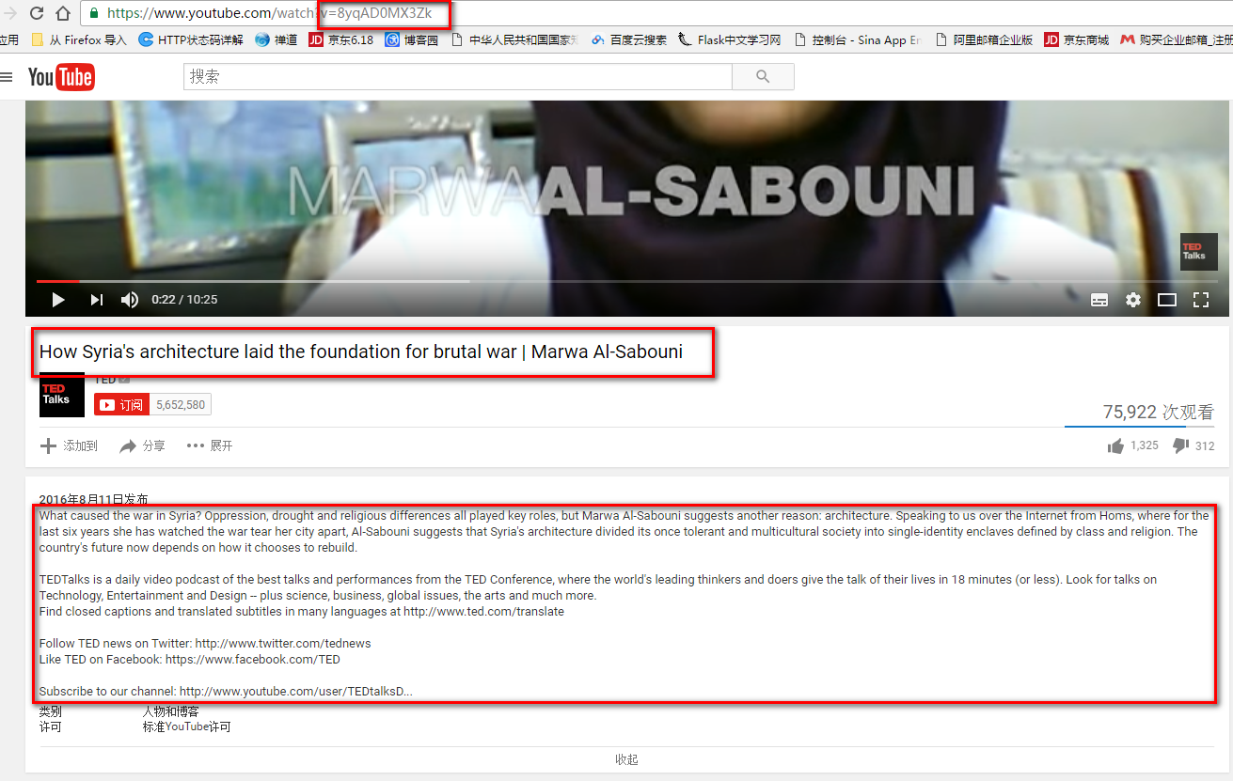
Youtube-dl

Slide 23
Youtube-dl
youtube-dl.exe "https://www.youtube.com/user/TEDtalksDirector/playlists"
--skip-download --simulate --get-url --get-id --get-title --get-description --write-sub
[youtube-dl.exe "https://www.youtube.com/user/TEDtalksDirector/playlists" --skip-download --
simulate --get-url --get-id --get-title --get-description>all.log]
[--get-title]
How Syria's architecture laid the foundation for brutal war | Marwa Al-Sabouni
[--get-id] 8yqAD0MX3Zk
[--get-description]
What caused the war in Syria? Oppression, drought and religious differences all played key roles, but Marwa Al-Sabouni suggests another reason: architecture. Speaking to us over the Internet from Homs, where for the last six years she has watched the war tear her city apart, Al-Sabouni suggests that Syria's architecture divided its once tolerant and multicultural society into single-identity enclaves defined by class and religion. The country's future now depends on how it chooses to rebuild. TEDTalks is a daily video podcast of the best talks and performances from the TED Conference, where the world's leading thinkers and doers give the talk of their lives in 18 minutes (or less). Look for talks on Technology, Entertainment and Design -- plus science, business, global issues, the arts and much more. Find closed captions and translated subtitles in many languages at http://www.ted.com/translate Follow TED news on Twitter: http://www.twitter.com/tednews Like TED on Facebook: https://www.facebook.com/TED Subscribe to our channel: http://www.youtube.com/user/TEDtalksDirector

Slide 24
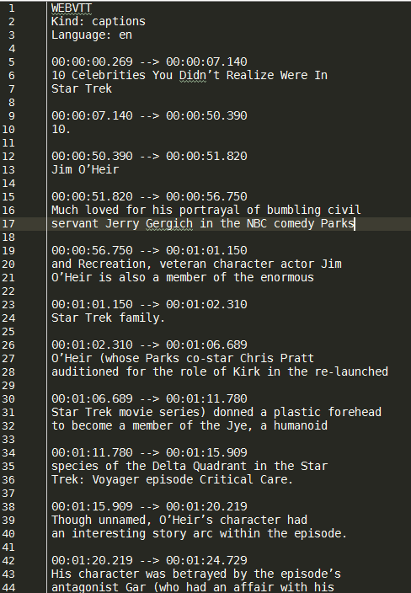
提取字幕（不下载视频）
>youtube-dl --skip-download --write-sub https://www.youtube.com/watch?v=0TjgZbVdOLA

Slide 25
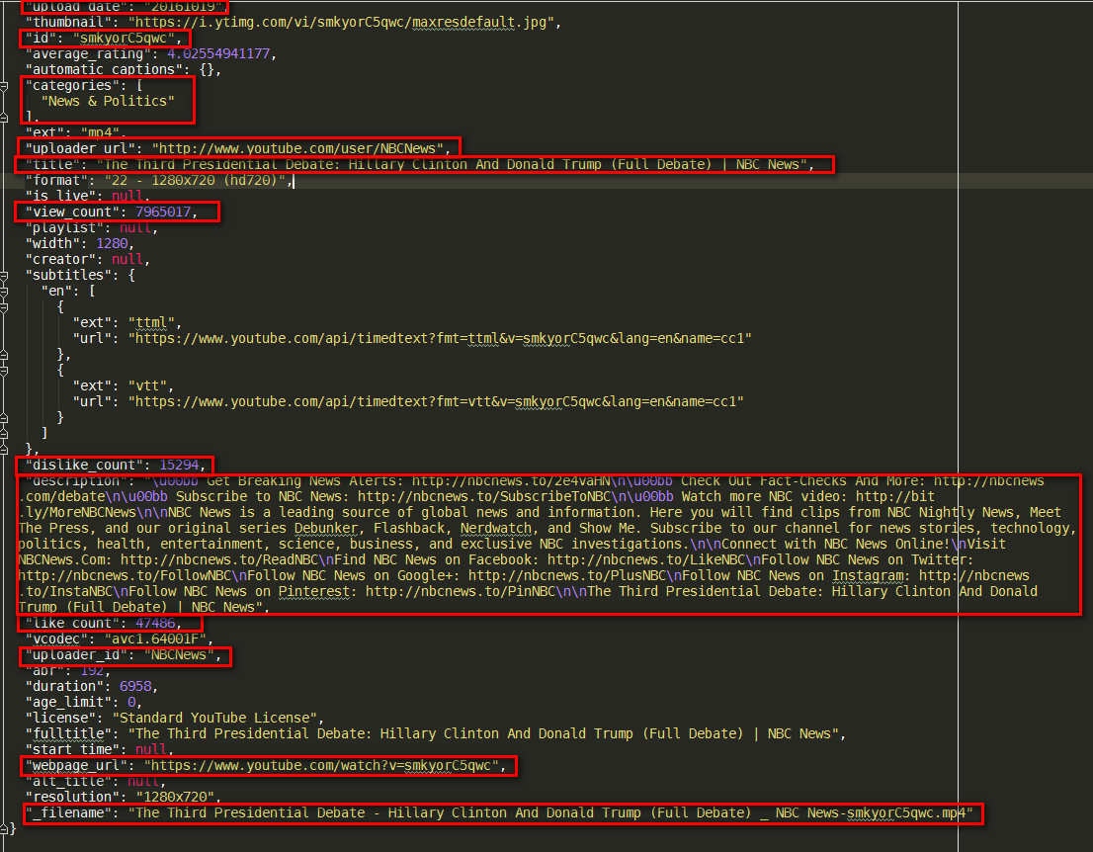
--print-json
Be quiet and print the video information as JSON (video is still being downloaded).
youtube-dl
--skip-download
--print-json "https://www.youtube.com/watch?v=smkyorC5qwc"

